Slide 1


Integration beyond point to point; Implementing integration patterns using Azure
Eldert Grootenboer

Slide 2


































Titanium Sponsors
Platinum Sponsors
Gold Sponsors

Slide 3



Eldert Grootenboer
@egrootenboer
Notes:
Technology Lead Azure & Integration

Slide 4
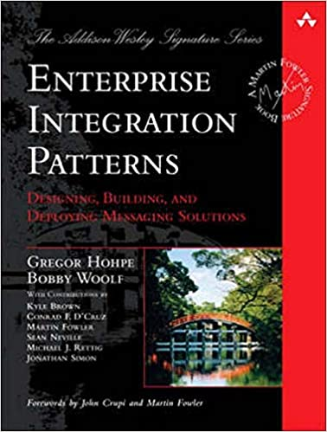
Enterprise Integration Patterns
https://www.enterpriseintegrationpatterns.com/

Slide 5
What are integration patterns
Recurring scenarios
Abstract
Reusable
Notes:
Patterns are accepted solutions to recurring problems within a given context.
They are abstract enough to apply to most integration technologies, but specific enough to provide hands-on guidance to designers and architects.
Patterns also provide a vocabulary for developers to efficiently describe their solution.
2

Slide 6
Why use integration patterns
Don’t reinvent the wheel
Use experts’ experience
Standards
Notes:
3

Slide 7
Integration patterns on Azure
Notes:
6

Slide 8
Azure Integration Services
Service Bus
Event Grid
API Management
Logic Apps
Functions
Data Factory
Notes:
5

Slide 9
Implementing integration patterns
Compose using different services
Various options
Azure Architecture Center
Notes:
7

Slide 10
Let’s implement some patterns!
Notes:
12

Slide 11
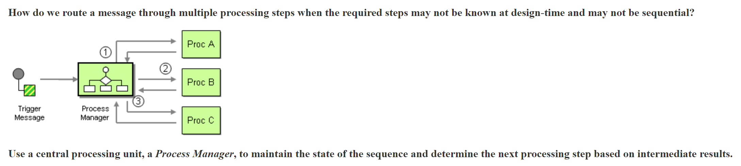
Process Manager
Notes:
9

Slide 12
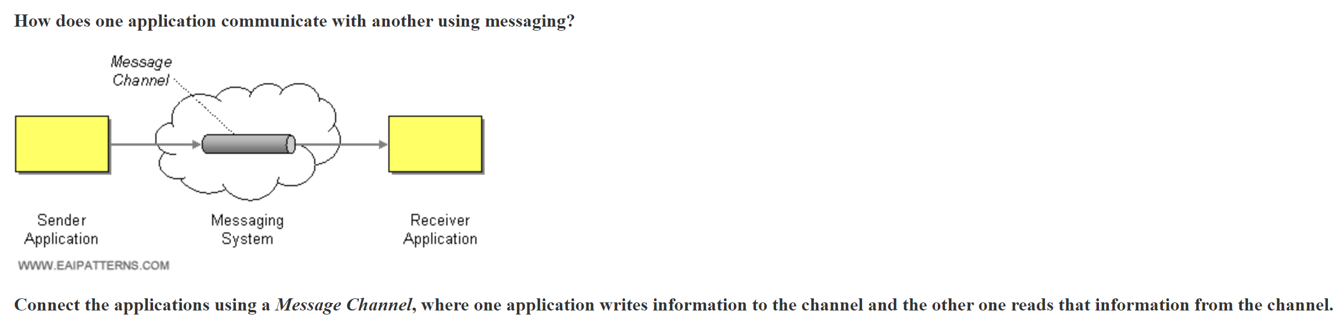
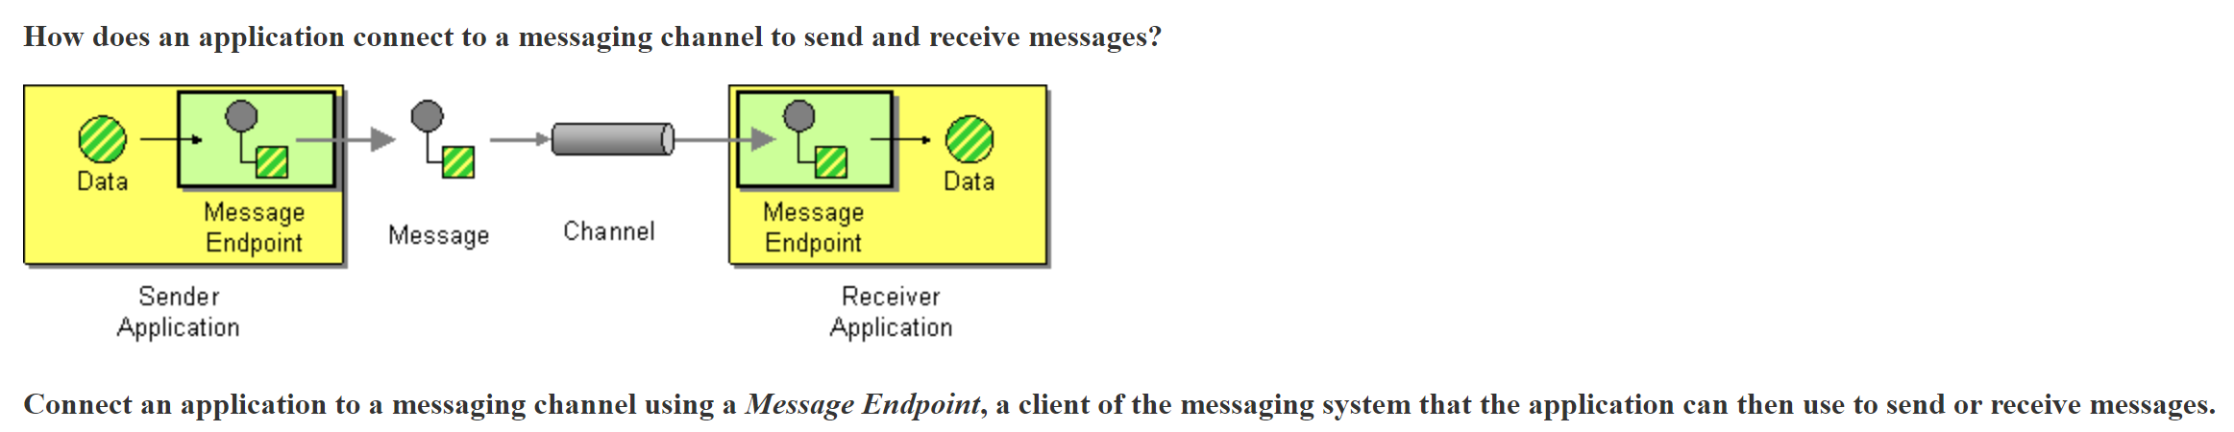
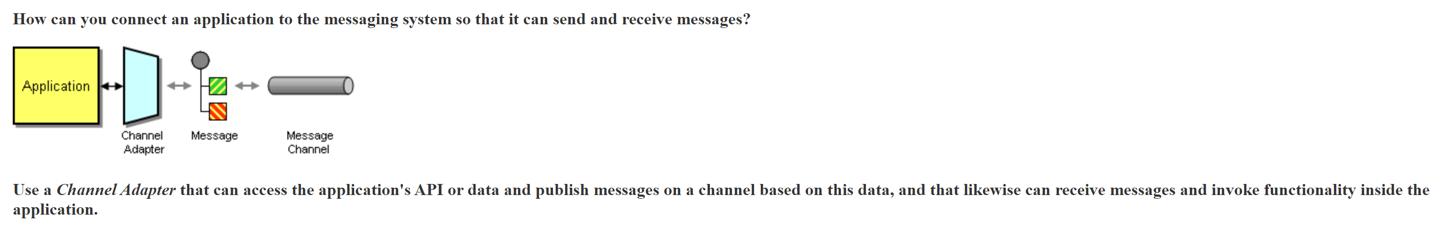
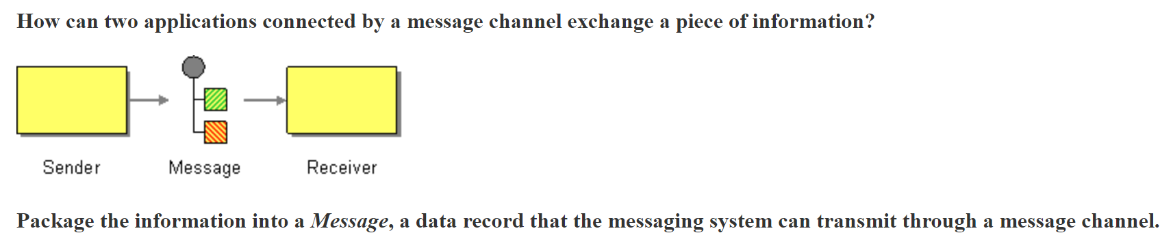

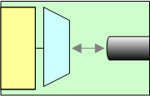
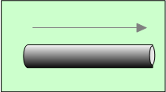
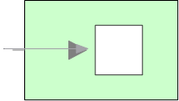
Simple integration
Message
Channel Adapter
Channel
Message Endpoint
Message
Notes:
Channel adapter: How can you connect an application to the messaging system so that it can send and receive messages?
Message channel: How does one application communicate with another using messaging?
Message endpoint: How does an application connect to a messaging channel to send and receive messages?
10
Channels are one-way
Which means communications are asynchronous
To model request/response use two channels
Applications are independent of the messaging system
So you need adapters that are able to take application specific
data and create a message and send it to a channel.
At the other side you need Message endpoints that can receive a message
From a channel and pass it to an application in an application specific way.
These are the glue components to bind applications to the messaging system.
If an application changes, then the adapter or endpoint needs changing
Isolates change across the system.

Slide 13
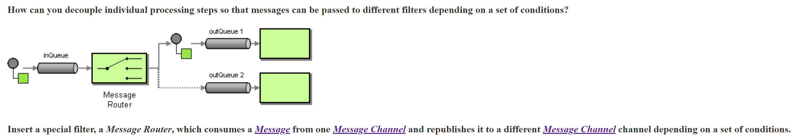
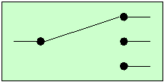
Message Router
Message
Channel Adapter
Channel
Message Router
Message Endpoint
Message
Notes:
Message router: How can you decouple individual processing steps so that messages can be passed to different filters depending on a set of conditions?
13

Slide 14
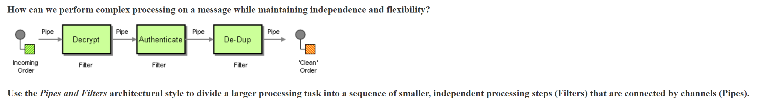
Pipes and Filters
Verify Status
Message
Channel Adapter
Filter
Channel
Message Router
Message Endpoint
Message
Notes:
Pipes and filters: How can we perform complex processing on a message while maintaining independence and flexibility?
16

Slide 15
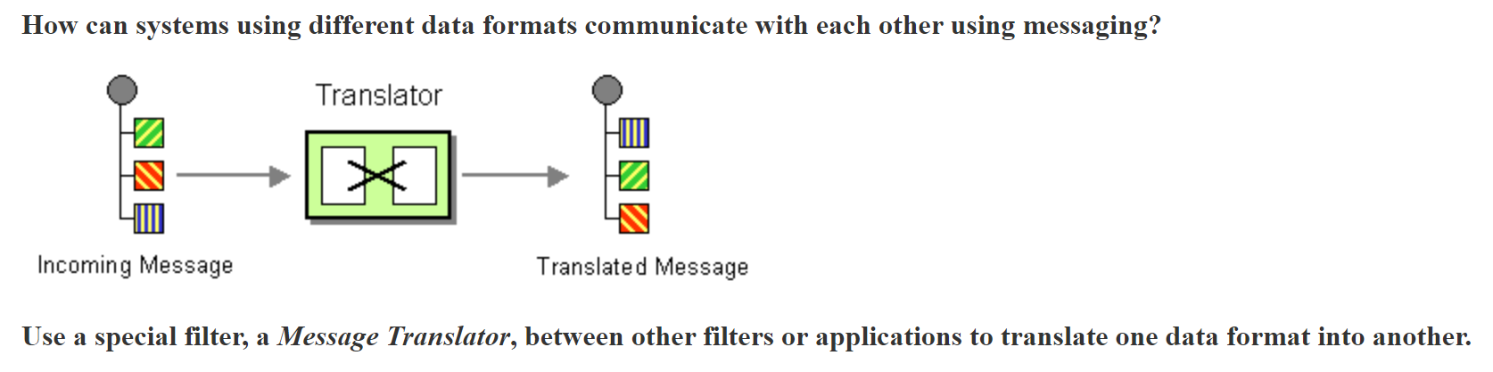
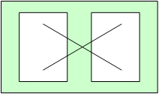
Message Translator
Verify Status
Message
Channel Adapter
Filter
Channel
Message Router
Message Translator
Message Endpoint
Message
Notes:
Message translator: How can systems using different data formats communicate with each other using messaging?
19

Slide 16
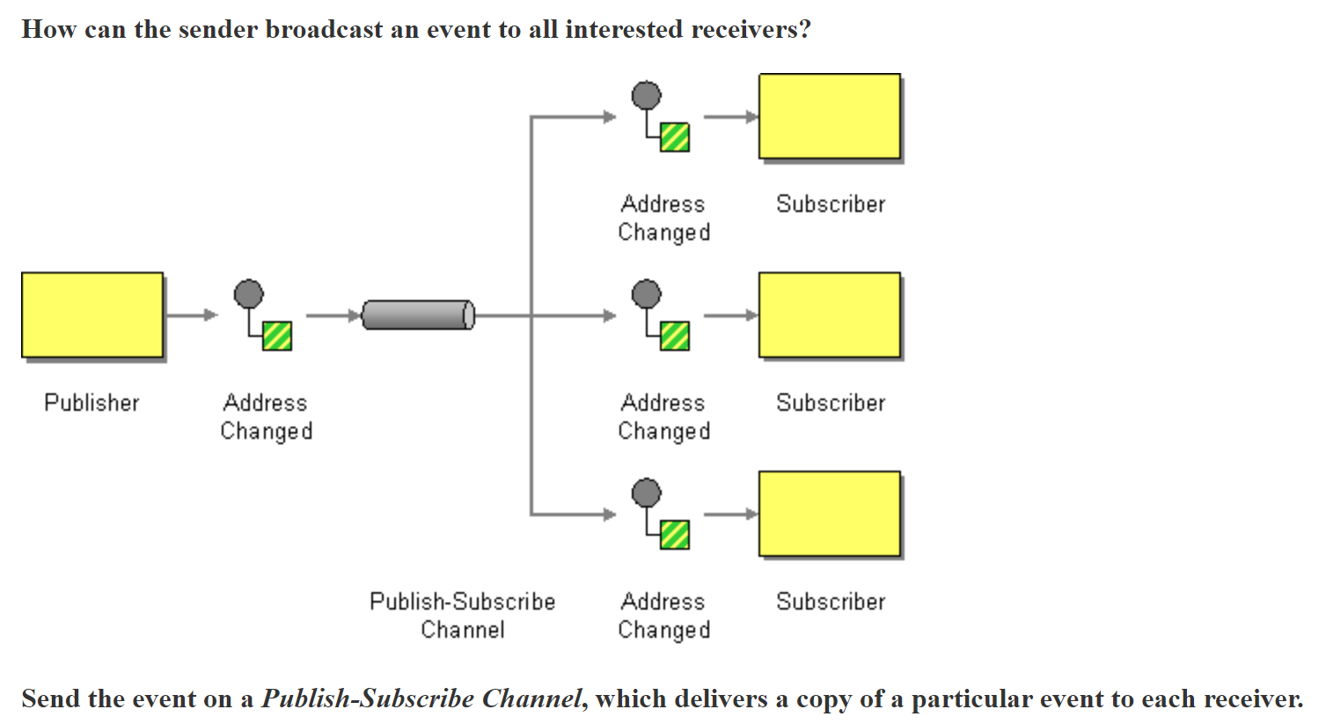
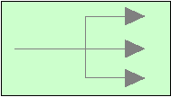
Publish-Subscribe Channel
Verify Status
Message
Channel Adapter
Filter
Channel
Message Router
Message Translator
Publish-Subscribe Channel
Message Endpoint
Message
Notes:
Publish-subscribe channel: How can the sender broadcast an event to all interested receivers?
22

Slide 17
Almost done…
Notes:
25

Slide 18
Key take-aways
Integration patterns allow to solve recurring challenges
Azure has a wide variety of services to implement these patterns
Choose the right services, especially with complex patterns
Notes:
Summary
Integration patterns form a common language that can be used in integration projects
These patterns are widely used within BizTalk and other integration platforms
BizTalk Server 2004 provides a number of pattern implementations out of the box
Many other patterns can be implemented easily within BizTalk
Patterns to aggregate, or resequence messages can be complex to implement, but sample implementations are available

Slide 19



Thank You!
@egrootenboer
eldert@eldert.net
https://www.linkedin.com/in/eldert-grootenboer
Notes:
Rustig spreken!

